Slide 1
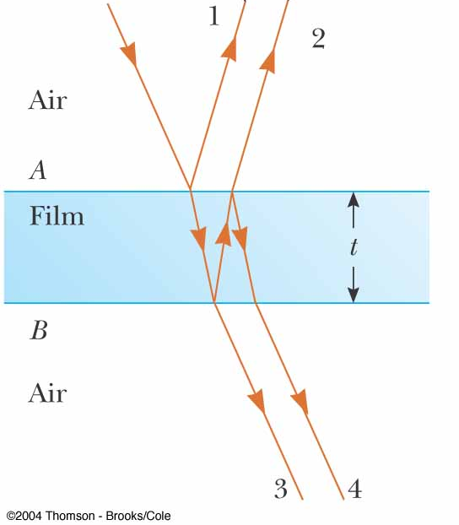
Question 223.8.1
In the figure, will rays 1 and 2 be in phase?
Yes
No
Can’t tell with the information given

Slide 2
Question 223.8.2
The thickness of the film is 2 wavelengths. The film has a refractive index that is bigger than 1. Will rays 1 and 2 be in phase?
Yes
No
Can’t tell with the information given

Slide 3
Question 223.8.2.5
The thickness of the film is 2 wavelengths. The film has a refractive index that is bigger than 1. Will rays 3 and 4 be in phase?
Yes
No
Can’t tell with the information given

Slide 4
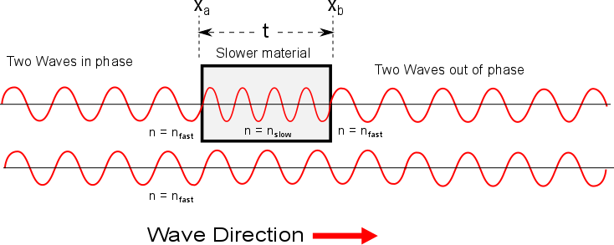

Slide 5
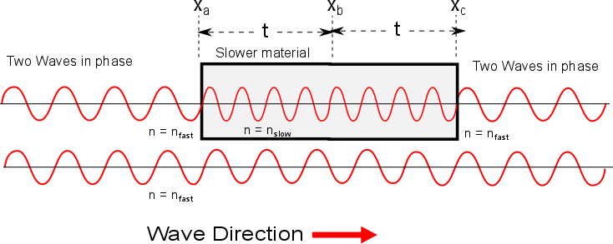

Slide 6
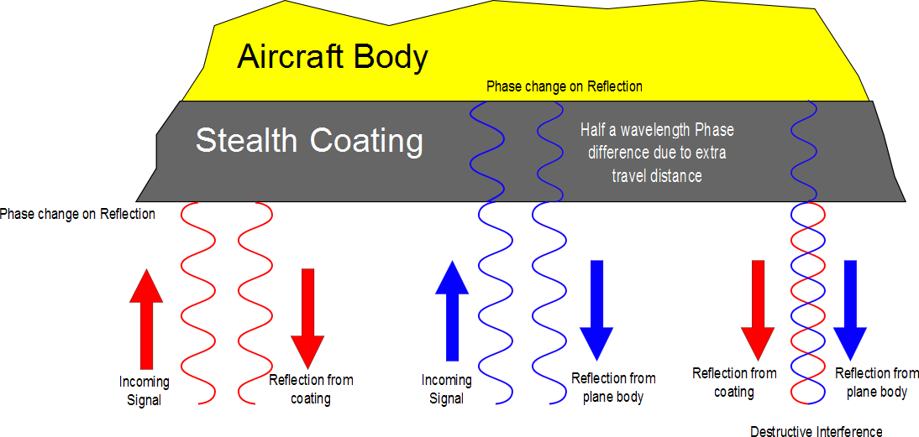

Slide 7
Loud Spot

Slide 8
Loud Spot
Full wavelength farther from the green wave center

Slide 9
Loud Spots

Slide 10
Dead Spot
Half a wavelength farther from the green wave center

Slide 11
Dead Spots

Slide 12
Question 223.8.3
I have two waves coming from speakers in my room. I am sitting 3 wavelengths away from one speaker and 4.5 wavelengths away from the other speaker. I hear..
Twice the normal loudness
4 times the normal loudness
8 times the normal loudness
Practically nothing

Slide 13
Question 223.8.4
I have two waves coming from speakers in my room. I am sitting 3 wavelengths away from one speaker and 6 wavelengths away from the other speaker. I hear..
Twice the normal loudness
4 times the normal loudness
8 times the normal loudness
Practically nothing

Slide 14
3m
2m
2m

Slide 15
Example of Beats

Slide 17
Question 223.9.1
Two graphs are shown below. Each graph represents the result of adding two waves together. For which graph is the frequency difference greater between the two original waves?.
A
B

Slide 18
Question 223.9.2
You are tuning a guitar by comparing the sound of the string with that of a standard tuning fork. You notice a beat frequency of 5Hz. You tighten the guitar string and the beat frequency rises to 8Hz. In order to tune the string exactly to the tuning fork, you should
Continue to tighten the string
Loosen the string
Impossible to determine

Slide 19
Flour
Sugar
Eggs
Chocolate Chip Cookies
Chocolate Chips
Baking Powder
Margarine
vanilla

Slide 20
Flour
Sugar
vinegar
Chocolate cake
cocoa
Baking Soda
oil
vanilla

Slide 21
Chocolate Chip Cookies
Mass of ingredient
Flour
Sugar
Eggs
Margarine
Vanilla
Chocolate Chips
Baking Powder

Slide 22
440Hz
880Hz
1320Hz
Trumpet A
1760Hz
2200Hz
2640Hz
3080Hz

Slide 23
440Hz
1320Hz
Clarinet A
2200Hz
3080Hz

Slide 24
Trumpet A
Amplitude of Partial
440Hz
880Hz
1320Hz
2640
3080
1760Hz
2200Hz

Slide 25
Clarinet A
Amplitude of Partial
440Hz
880Hz
1320Hz
2640
3080
1760Hz
2200Hz

Slide 28
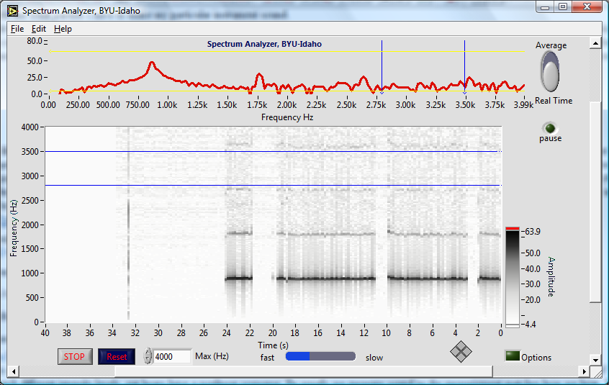
Peaks show partials

Slide 29
Strip chart also shows partials, darker black means higher peak
It is like looking at the graph above, but from above, and repeated for each second of playing

Slide 30
Notice that there are non-harmonic partials in this instrument too!

Slide 31
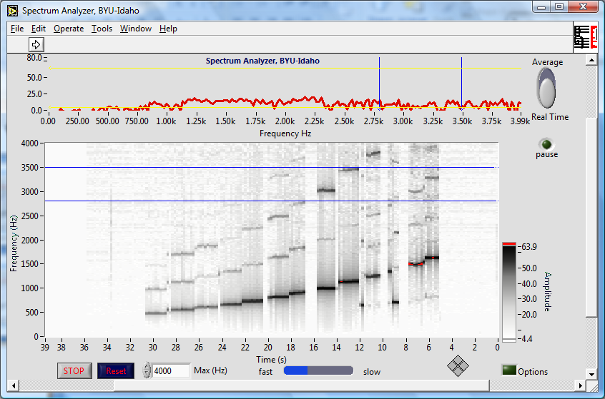
Bamboo six holed flute

Slide 32
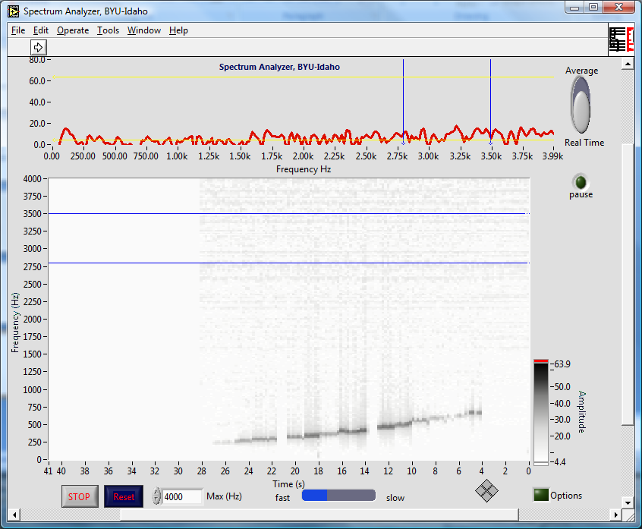
Ocarina

Slide 33
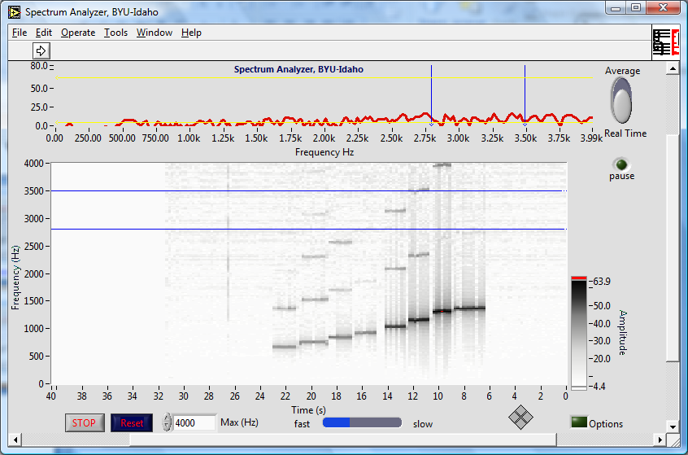
Recorder

Slide 34
Recorder

Slide 35
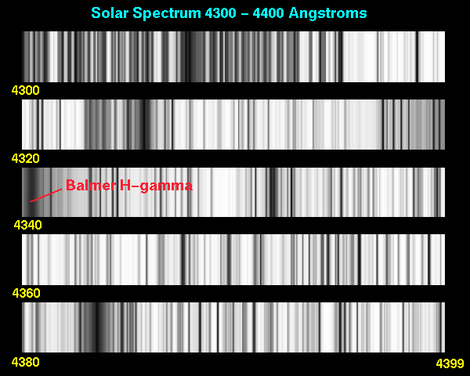
Application: Light Spectra

Slide 36


Slide 37
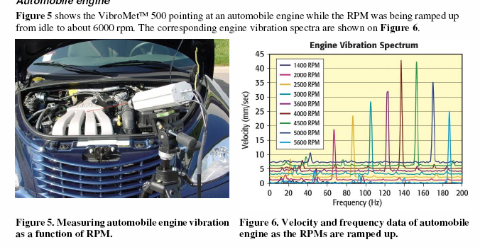
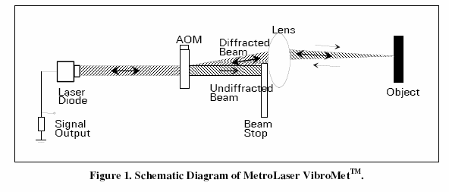
Application: Industrial Monitoring

Slide 38
Application, Vibrometry Target ID

Slide 39
Example: Square Wave

Slide 40
Example: Square Wave

Slide 41
Example: Square Wave, More Terms

Slide 42
Example: Square Wave

